Slide 1
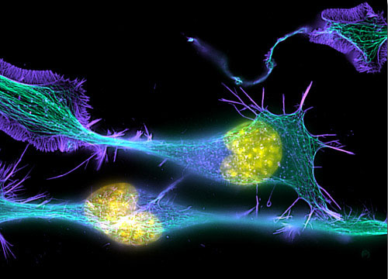
Principles & Practice of Light Microscopy 6
Special Techniques
(FRET, FRAP , FLIP , FLIM , FCS, molecular sensors…)
(Image: T. Wittman, Scripps)

Slide 2
Monitoring molecular movement by microscopy
General idea: optically mark one region of the cell, follow where it goes at later times.
Implementation
Uncaging (old)
FRAP, FLIP: photobleaching
Photoactivation

Slide 3
FRAP Fluorescence Recovery after Photo-bleaching
Need: to probe transport
Idea: bleach in one area,
watch recovery by transport from other areas

Slide 4
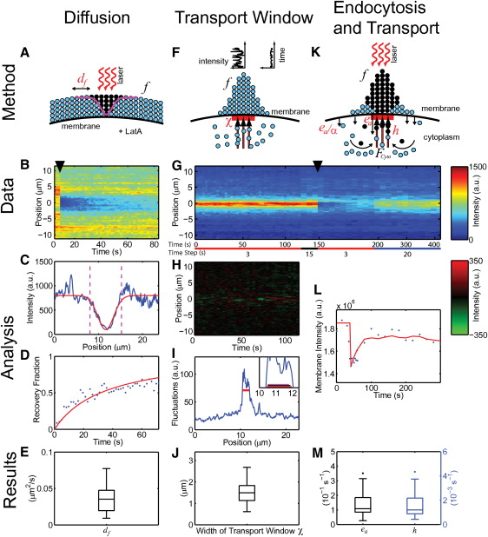
Measuring Cdc42 diffusion constant in yeast
Result: d_{f} = (0.036 ± 0.017) μm²/s
Marco et al. 2007 Cell 129:411-422

Slide 5
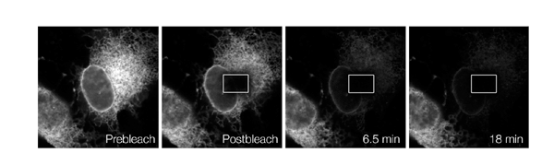
FLIP Fluorescence Loss in Photo-bleaching
Need: probe connectivity
Idea: bleach in one compartment,
watch loss in connected compartments by exchange
Bleach one area repeatedly. Entire ER dims.
⇒ ER is contiguous

Slide 6
Photo-Activation (Better?) FRAP/FLIP alternative
Some fluorophores can be activated by light
Photo-uncagable dyes
GFP-family proteins
Look for weak light
against dark background
Instead of slight dimming
of bright background
Activate a small area
Watch fluorescence spread

Slide 7
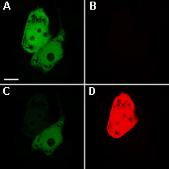
Photo-Activativatable Proteins
Off-On
PA-GFP, PS-CFP
Color change
Kaede, KikGR, Eos,
Dendra (activatable by blue)
Reversibly Switchable
asCP, KFP (tetrameric)
Dronpa
Dendra2 demo
green
red
Activate
before
after

Slide 8
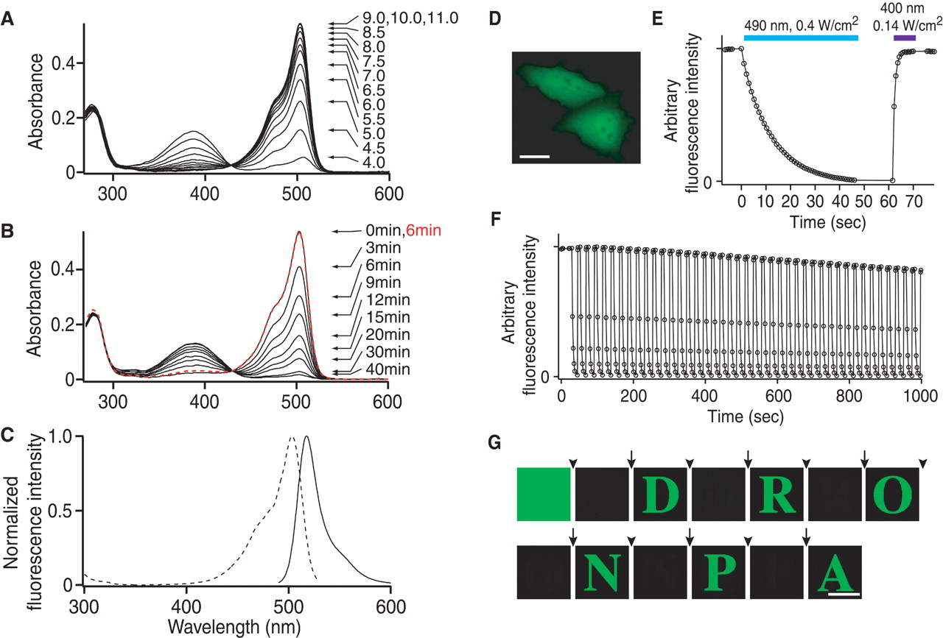
Dronpa – photoswitchable on and off
Ando et al. 2004, Science 306: 1370-1373

Slide 9
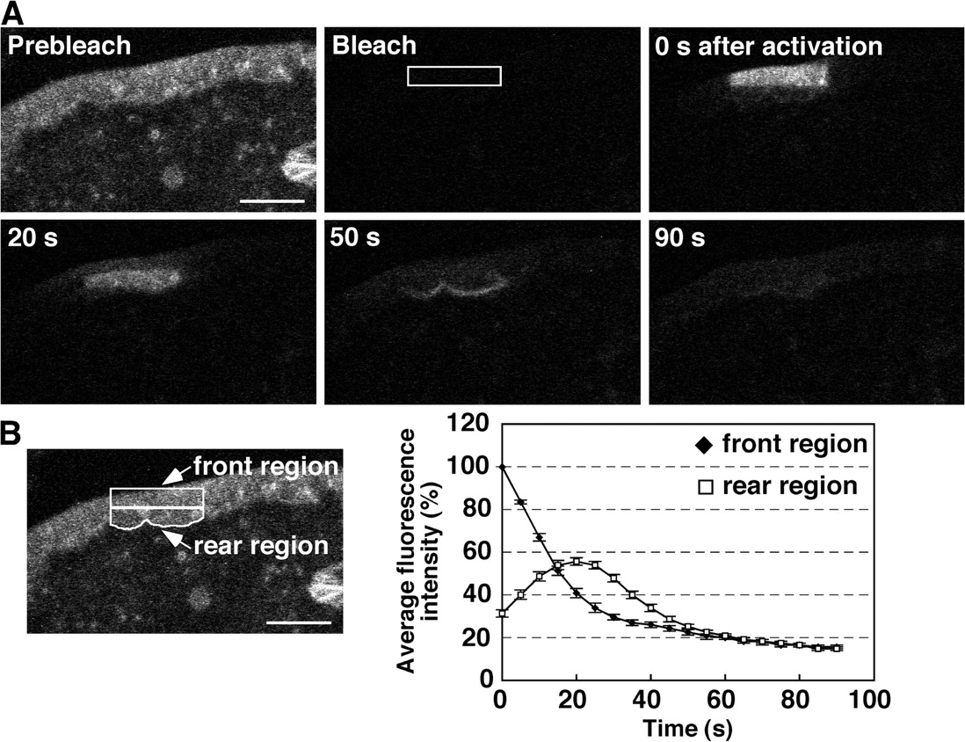
Tracking actin flow with Dronpa
Kiuchi, T. et al. J. Cell Biol. 2007;177:465-476

Slide 10
Hardware for photoactivation / photobleaching
Need: controlled illumination of a region in the sample

Slide 11
Laser-scanning confocal microscope
Projection Lens
Intermediate image plane
Tube lens
Objective
Sample
Object plane
Use mirrors to adjust angle at back focal plane – changes location of laser spot at sample

Slide 12
Laser-scanning confocal microscope
Projection Lens
Intermediate image plane
Tube lens
Objective
Sample
Object plane

Slide 13
Laser-scanning confocal microscope
Pros
can bleach / activate any shape ROI by scanning point by point
Cons
Slow
Need a laser scanning confocal

Slide 14
Can control field of view with field iris
Camera
Final image plane
Projection Eyepiece
Imaging
path
Intermediate image plane
Tube lens
Objective
Sample
Object plane
Condenser lens
Aperture iris
Illumination
path
Field lens
Field iris
(image plane)
The field iris
controls the
illuminated
field of view
Collector
Light source
(pupil plane)

Slide 15
Better idea: Spatial Light Modulator
Illumination
Spatial Light Modulator
Intermediate image plane
Tube lens
Objective
Sample
Object plane
Can project any image onto sample

Slide 16
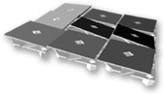
Digital Micromirror Device
Array of rotatable mirrors
Off
On
Spatial Light Modulator
Intermediate image plane
Tube lens
Illumination
Objective
Sample
Object plane
Pros: Fast, can project any arbitrary image
Cons: Intensity is relatively low

Slide 17
FLIM Fluorescence Lifetime Imaging
Measure the lifetime of the excited state
Separate fluorophores with similar spectra
Detect environmental parameters that
affect lifetime
(FRET, pH, ...)
1/e
τ₁
τ₂

Slide 18
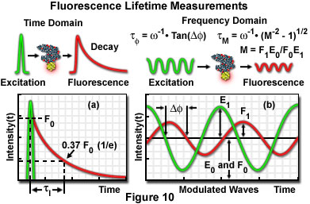
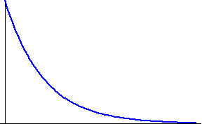
FLIM Measurement approaches
Frequency domain
Modulated excitation
Lock-in detect emission phase
Time domain (pulsed exc.)
Gated intensifier
Photon inefficient
Time-correlated
single photon counting
Very efficient
≤ one photon per pulse ⇒ slow
Time gates

Slide 19
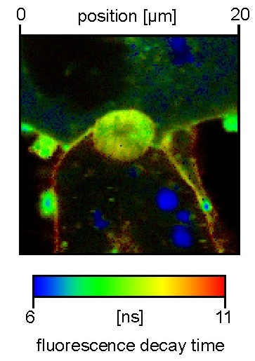
FLIM Examples
Hepatocyte membrane-stained
with NBD, which has a
hydrophobicity-dependent lifetime
(TCSPC, 3 minutes for 300x300 pixels )

Slide 20
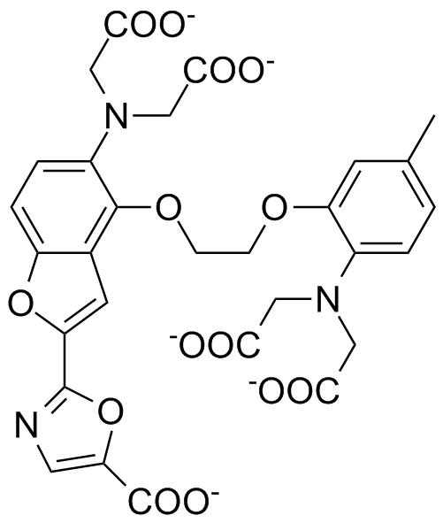
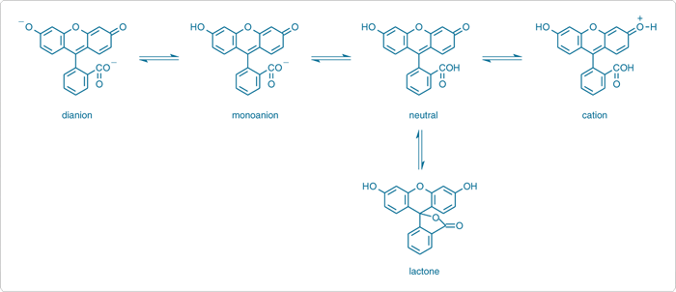
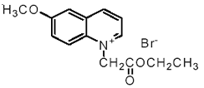
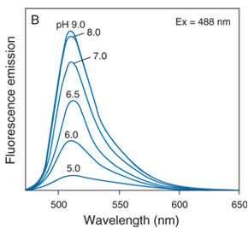
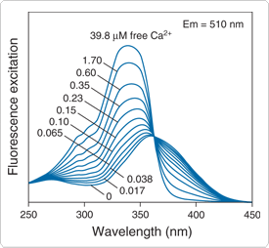
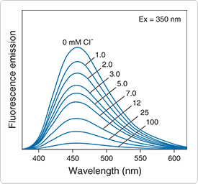
Environment-sensitive fluorophores
Many: pH, ions (Ca²⁺, Mg²⁺, Na⁺, K⁺, etc.), voltage, hydrophobicity,…
Fura-2
Fluorescein
MQAE

Slide 21
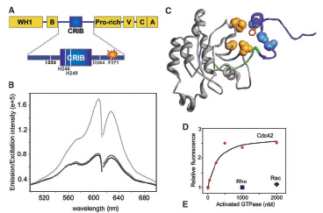
Environment-sensitive fluorophores
I-SO
Nalbant et al. 2004, Science 305: 1615-1619

Slide 22
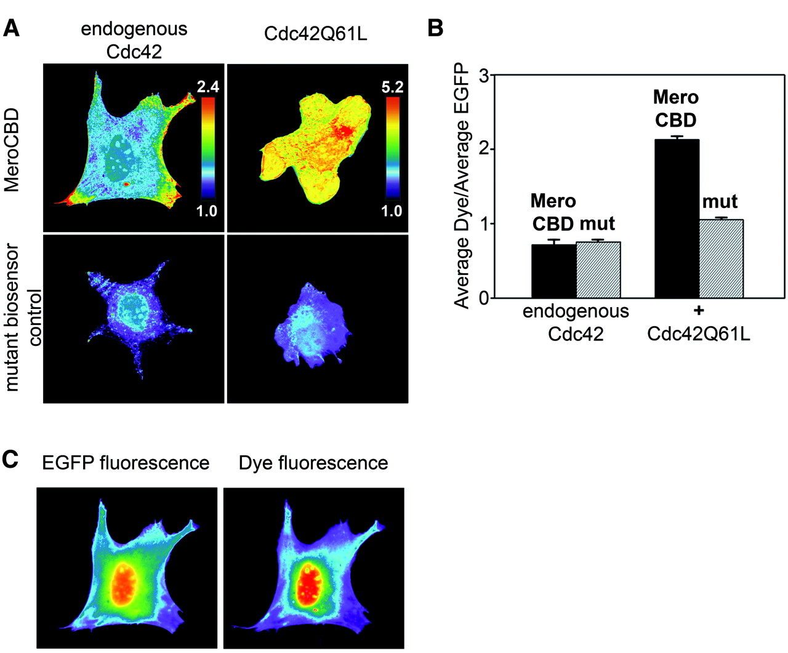
Imaging Cdc42 activation
Fuse sensor to GFP; I-SO/GFP ratio is proportional to degree bound

Slide 23
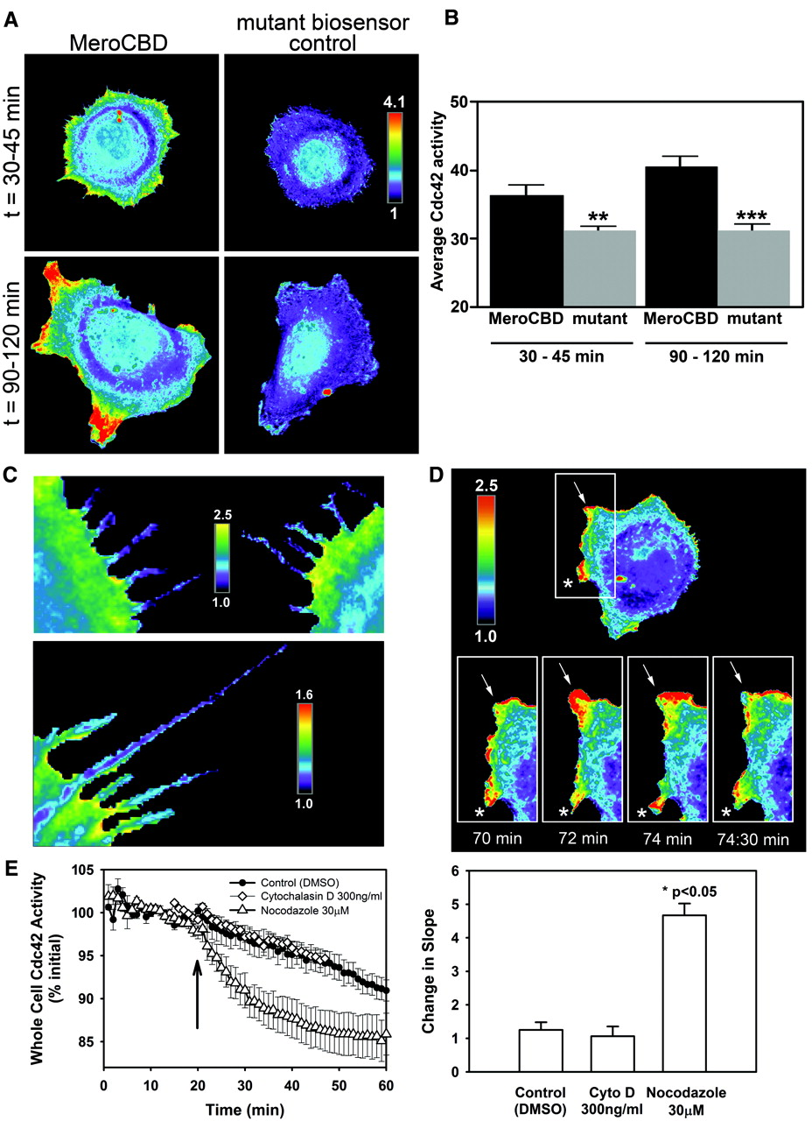
Monitoring Cdc42 activation

Slide 24
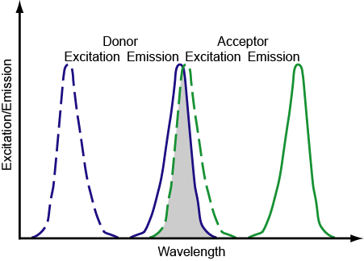
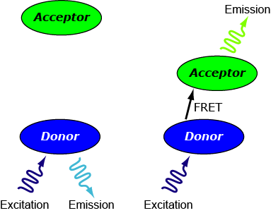
Fluorescence Resonance Energy Transfer
Sensitive to distances on the order of 10 nm, 20-fold below resolution limit

Slide 25
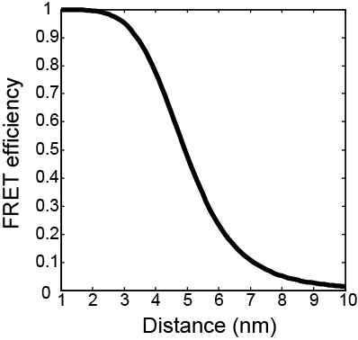
Distance dependence of FRET
1
E =
1+ (r⁶/R₀⁶)
R₀⁶ ∝ k² n⁻⁴ Q_{D} J(l)
Overlap between donor emission and acceptor excitation
Donor quantum yield
Refractive index
Orientation between fluorophores
For CFP-YFP,
50% transfer at R₀ = 4.9 nm

Slide 26
Good FRET pairs
CFP/YFP – use A206R mutants if dimerization is problematic
GFP/mCherry or other FP pairs – not so well validated
Fluorescein/Rhodamine
Cy3/Cy5 or Rhodamine/Cy5
Many other small molecule pairs

Slide 27
FRET Theory
k² = (cos q_{T} – 3 cos q_{D} cos q_{A})²
For rapidly tumbling molecules, can average over all possible orientations to give k² = 2/3
But rotational correlation time for GFP is ~16 ns; fluorescence lifetime is ~3ns
q_{A}
Acceptor
q_{D}
Donor
q_{T}
Acceptor
Donor

Slide 28
Effects of FRET
Donor lifetime shortened
Acceptor emission depolarized
Donor fluorescence quenched
Acceptor fluorescence enhanced on donor excitation

Slide 29
Measuring FRET
Donor lifetime shortened
Can measure by fluorescence lifetime imaging, but requires specialized instrumentation

Slide 30
Measuring FRET
Acceptor emission depolarized
Can measure by fluorescence polarization microscopy

Slide 31
Measuring FRET
Donor fluorescence quenched
Acceptor fluorescence enhanced on donor excitation
Can measure by donor recovery after acceptor photobleaching
Easy, but very sensitive to degree of photobleaching

Slide 32
Measuring FRET
Donor fluorescence quenched
Acceptor fluorescence enhanced on donor excitation
Can measure by quantitative measurement of acceptor enhancement on donor excitation
Easy, but crosstalk needs to be corrected for

Slide 33
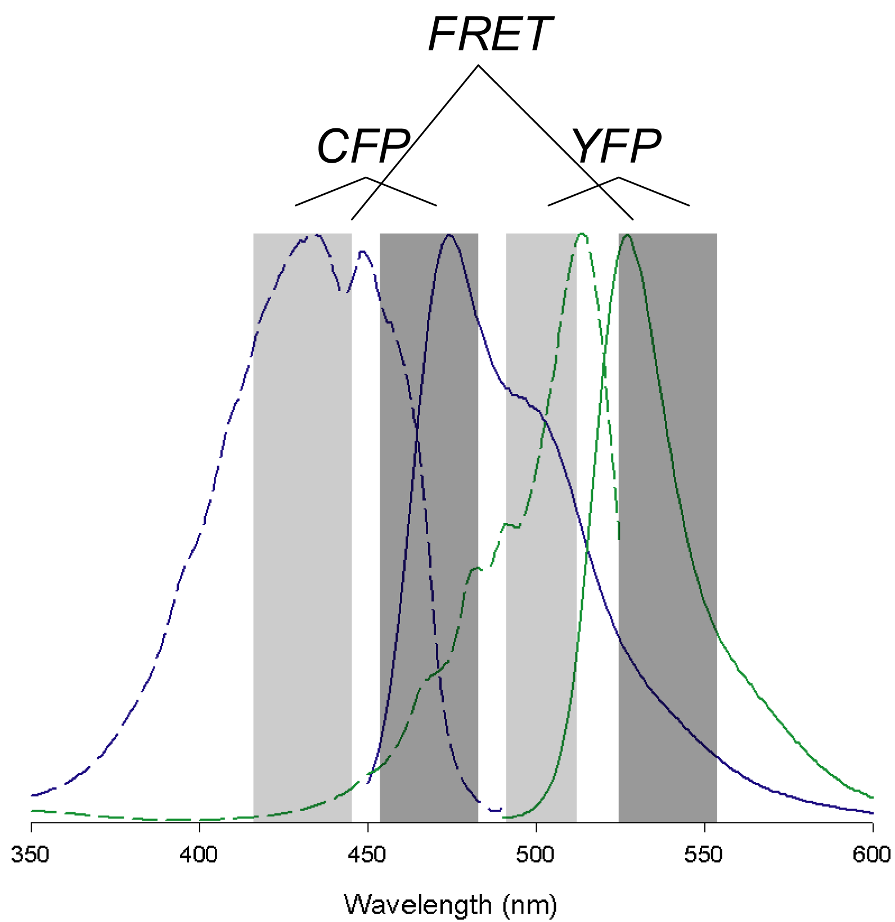
A problem: crosstalk into FRET channel
Ex
Correct using measurements from CFP- and YFP- only cells
Em

Slide 34
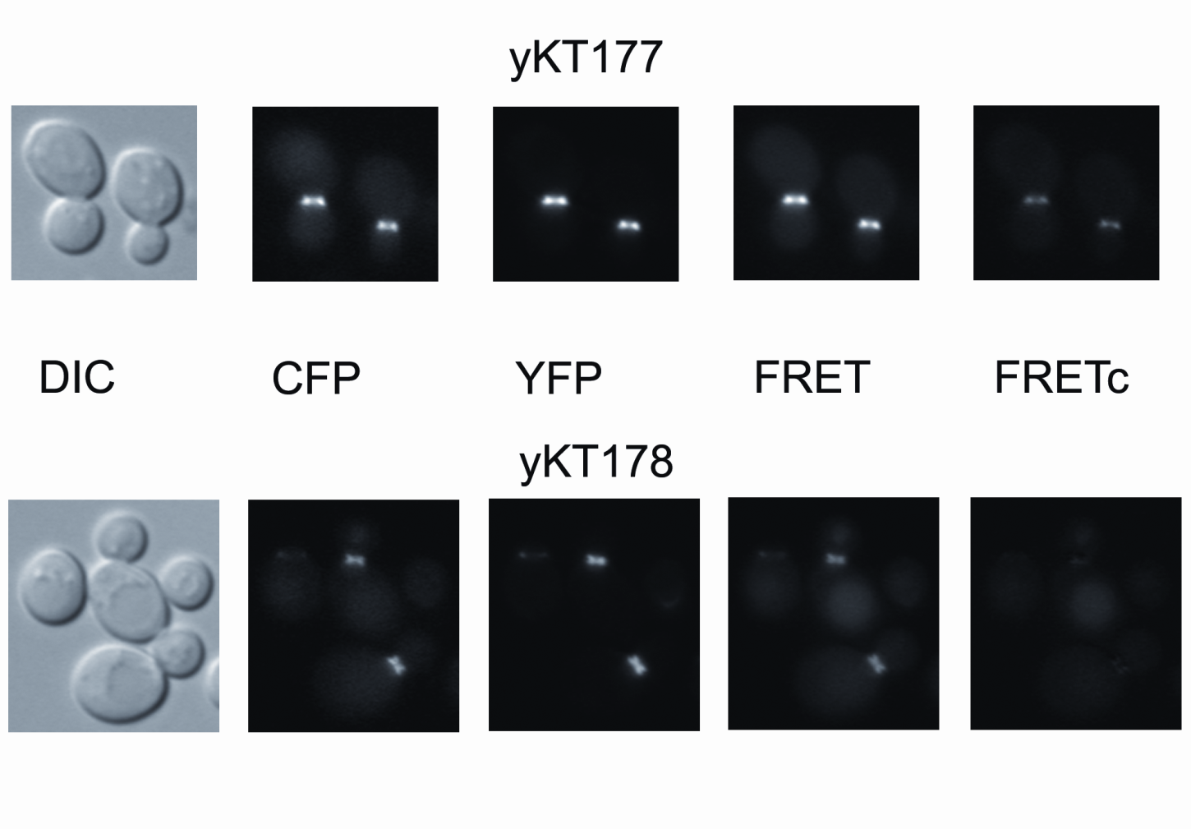
Crosstalk correction

Slide 35
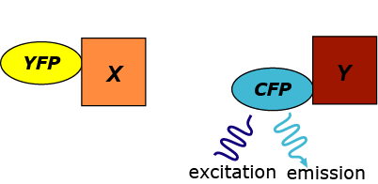
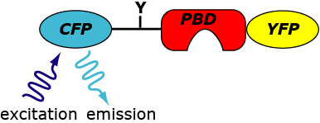
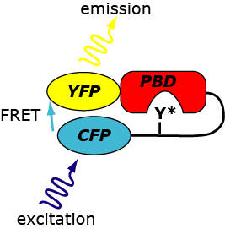
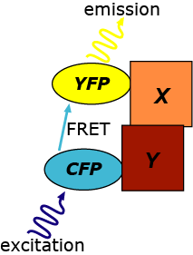
Types of FRET experiments
Intramolecular
Intermolecular

Slide 36
Types of FRET experiments
For intramolecular FRET, CFP and YFP are always present in a 1:1 ratio
Ratiometric imaging can be used as a rough measure of the amount of energy transfer
Intramolecular

Slide 37
Types of FRET experiments
For intermolecular FRET, the relative abundance of CFP and YFP is not controlled and can change over time.
Ratiometric imaging is no longer possible, and additional corrections are necessary.
Intermolecular

Slide 38
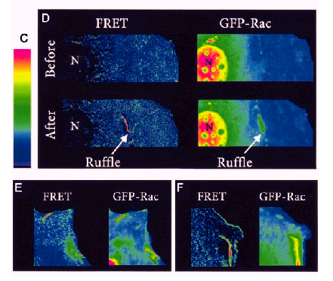
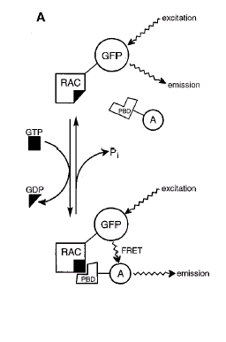
Using FRET to monitor Rac activation
Kraynov et al. 2000, Science 290: 333

Slide 39
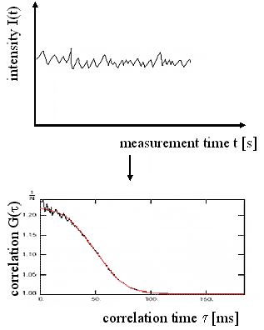
FCS Fluorescence Correlation Spectroscopy
Small volume → only a few molecules → random fluctuations
Study the noise
Conclude about random processes at different time scales
Small excitation volume
Random molecular processes:
Diffuse in and out
Adopt different states
Bind or react
Photobleach
…
Study the auto-
(or cross-) correlation

Slide 40
Image Correlation Spectroscopy Image FCS
Sense the random fluctuations of fluorescence
within an image or image sequence
Much slower than point FCS, but get whole area
Can see where you are & deal with motion
Can do spatio-temporal analysis
Image series
Measure time and space
variations in intensity

Slide 41
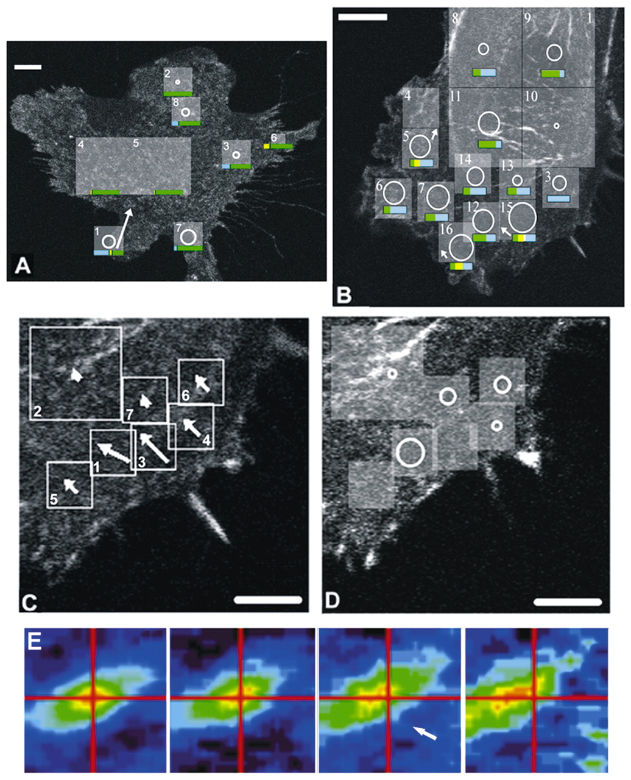
Image Correlation Spectroscopy
Areas
analyzed
Flow
vector
Stationary fraction
Flowing fraction
Diffusing fraction
=10min
diffusion
length
Spatio-temporal
autocorrelation
0 s
5 s
10 s
15 s

Slide 42
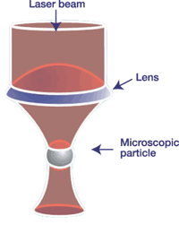
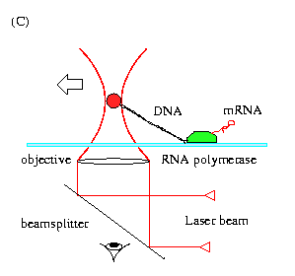
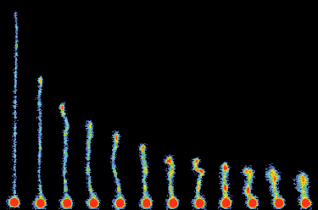
Optical Tweezers
Mechanically manipulate
the specimen with light
Why?
Measuring force and displacement
of a single polymerase molecule
DNA recoil after stretching

Slide 43
Optical Tweezers How does it work?
Photons carry momentum
Changing photon direction requires a force
More light refracted away from high intensity region
→ Force toward intensity maximum
Alternative way to look at it:
Field energy is less in higher index
System energy depends on particle position
dE/dx = Force

Slide 44
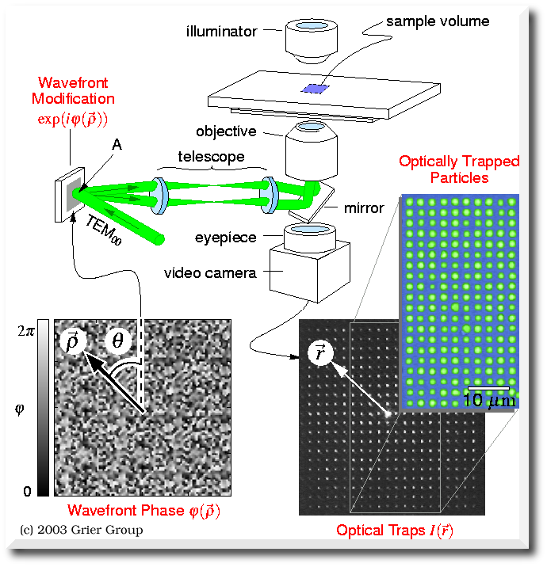
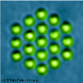
Holographic Optical Tweezers
Many traps at once
Independently movable
Made using a computer-controlled
spatial light modulator in a pupil plane

Slide 45
Further reading
www.microscopyu.com
micro.magnet.fsu.edu
Molecular Probes Handbook (probes.com)
James Pawley, Ed. “Handbook of Biological Confocal Microscopy, 3rd ed.”
Acknowledgements
Mats Gustafsson

